Slide 1
The Impact of High Temperatures on Child Anthropometric Outcomes Worldwide
Natalia Cancino,University of San Francisco 2023, MS IDEC.

Slide 2

Introduction
Climate change
Rising temperatures
Changes in precipitation patterns
Rising sea levels
Ocean acidifications
Shifts in the timing
seasons
IMPACTS
ON
Food security
Care
Sanitation
Socioeconomic conditions
IMPACTS
ON
Nutritional health impacts
Notes:
Climate change is a major global issue with significant impacts
Research has shown that climate change has serious implications on child nutrition, affecting critical determinants such as dietary intake and health which are influenced by underlying factors such as food security, health, sanitation, and socioeconomic conditions.

Slide 3
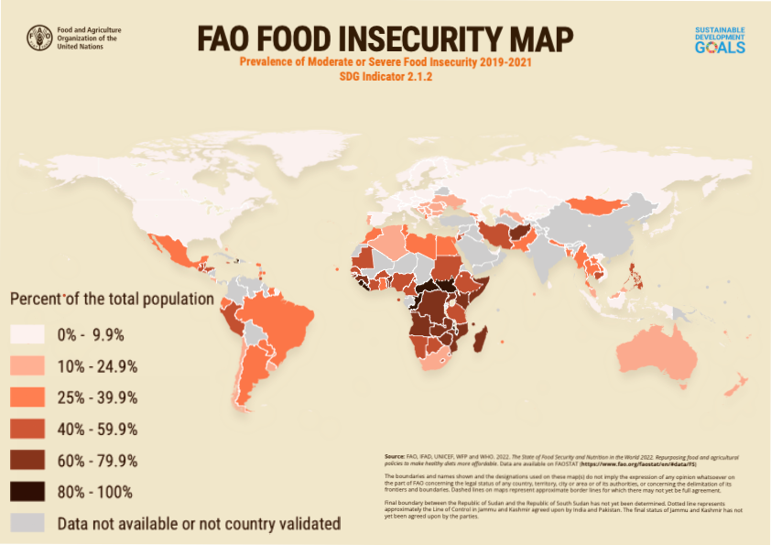
Introduction
Notes:
Extreme heat can lead to crop failures and droughts,
As a result, families and communities may experience difficulty to access adequate nutrition, which can have a significant impact on child nutrition.
This map from the Food and Agriculture Organization shows various regions with the highest levels of food insecurity.

Slide 4
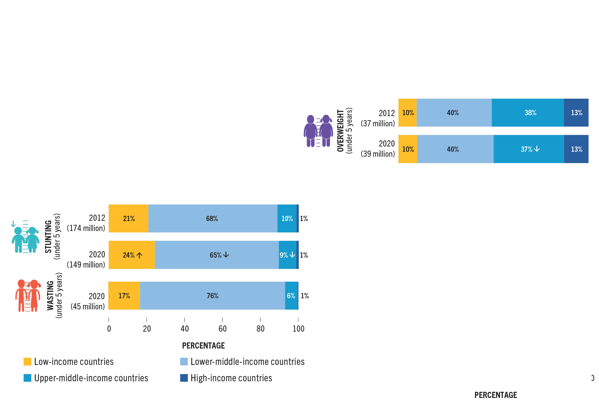
Introduction
(FAO) The State of Food Security and Nutrition in the World 2022
Notes:
The State of Food Security and Nutrition in the World 2022 reported highlights the alarming prevalence of child stunting and wasting in different income groups.
It is estimated that over 149 million children under the age of five in these countries suffer from stunting, while more than 45 million are affected by wasting.

Slide 5
Research question
How do high temperatures impact the measurement outcomes of children aged 1 to 5 across different regions and continents worldwide?
Notes:
Given the current and persistent threat of climate change and global warming, it's imperative that we further investigate the link between high temperatures and child undernutrition.
This research aims to address the question of how high temperatures impact the measurement outcomes of children aged 1 to 5 in various regions and continents across the world.
To help answer our research question, we looked at various studies that explored how high temperatures affect children's physical measurements.

Slide 6
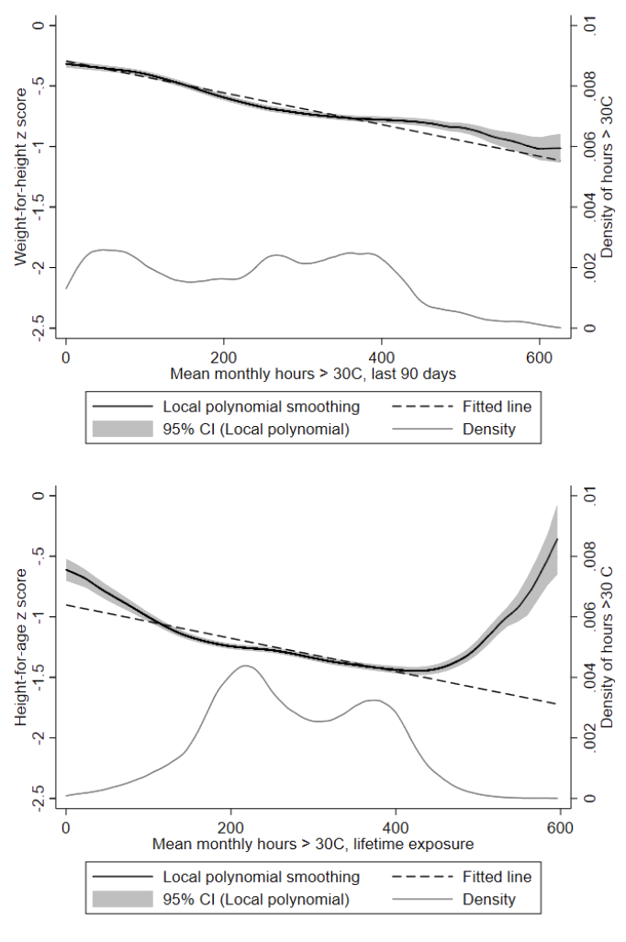
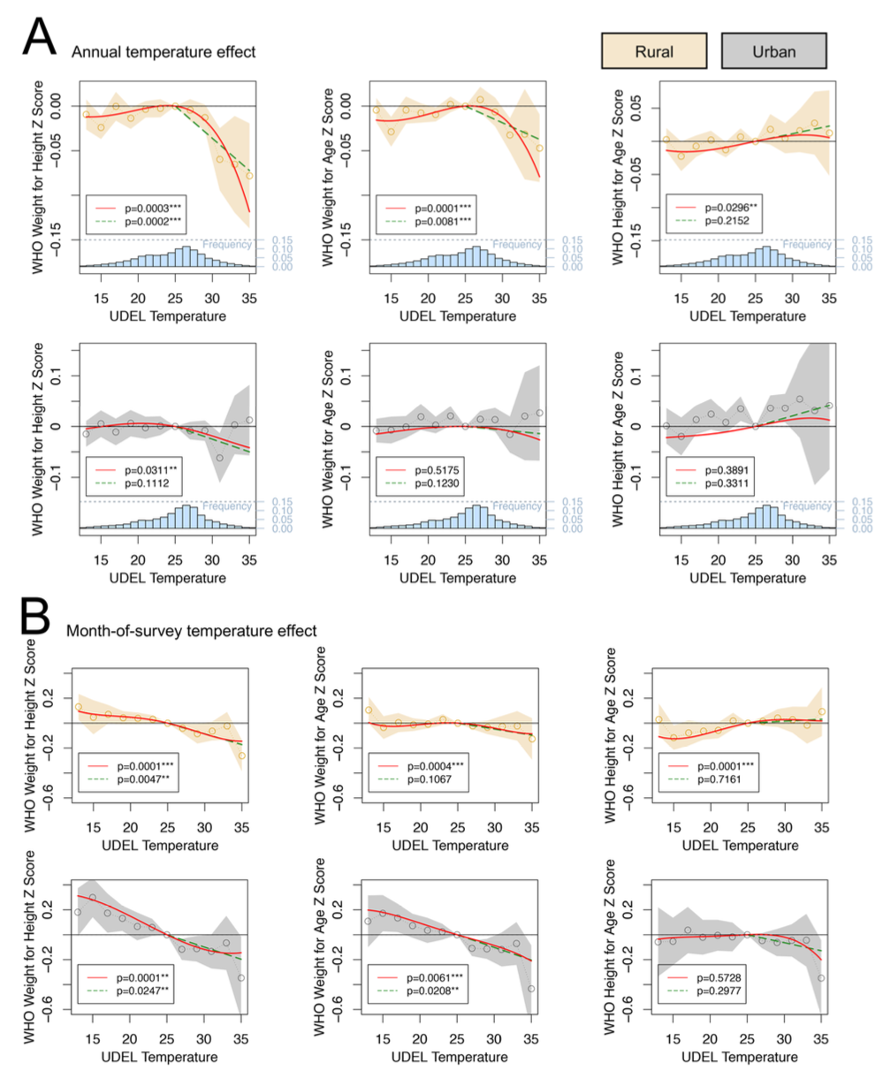
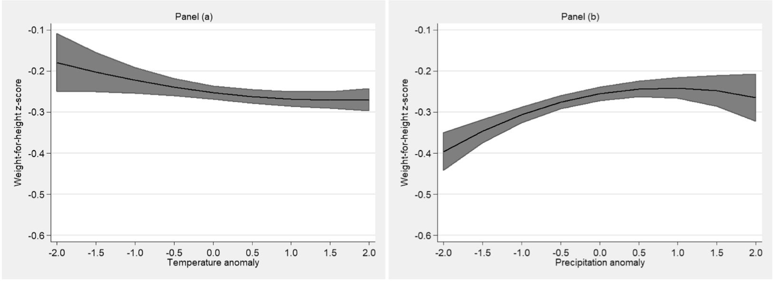
Background
Blom et al(2019)
Baker and Anttila-Hughes (2020)
Thiede and Strube (2020)
Notes:
Blom found that in 5 countries, of west africa children exposed to temperatures above 30- and 35* C are associated to decrease of WHZ and HAZ scores, with greatest impact on children aged 8 to 22.
Baker and Anttila-Hughes, they studied 30 countries in sub-sahara africa ann found that child weight decreases when children are exposed to temperatures above 25•c and intensifies with age,and that children in rural areas are more impacted in their weight for height, and weight for age.
Thiede and Strube- investigated 18 sub-Saharan African countries and revealed that low precipitation is associated with a decrease in child weight, while high temperatures increase the risk of wasting

Slide 7
Data Sources
DHS program Data
Child anthropometric data, household socioeconomic information, and type of residence, geo location (GPS).
University of Delaware’s gridded station-based
This dataset consists of Terrestrial Air Temperature: Monthly Time Series from 1900 to 2018
World Bank Data Bank
Data on regions, income groups, and GDP per capita for each country
Notes:
1.The data sources used in this research are the DHS program data, which contains information about child anthropometrics and household demographic information.
2. Monthly temperature data from the University of Delawer’s gridded station-based.
3. And from the word bank, information about geographic, income classifications and economic indicators.

Slide 8

Methods
Standard fixed-effects ordinary least squares regressions model of temperature on child anthropometric outcomes.
A ➙ Anthropometric measurements of child.
T➙ Temperature in the month of interview.
γ➙ Child controls such as age in months, rural residence, gender, birth order
α➙ Maternal controls such as age, marital status, the total number of children, and education level
Fixed effects
ω ➙ Year of the interview
σ➙Country indicator
μ➙Month of the interview, for arbitrary seasonal effects

Slide 9
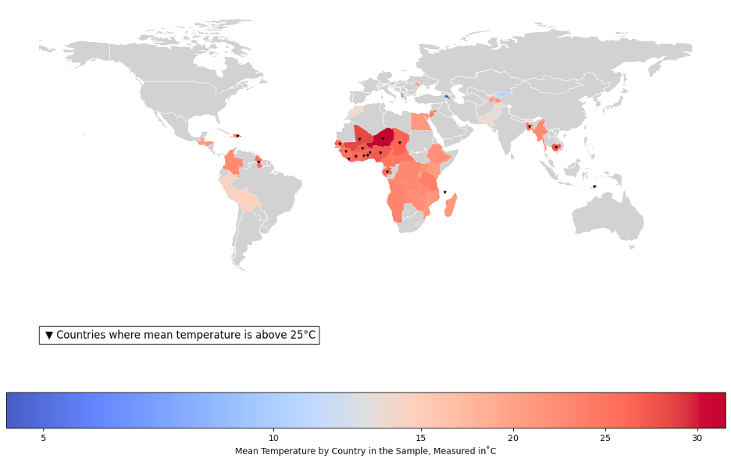

Results
Summary Temperature
Countries | 54 countries
Min temperature | -4.19 °C
Max temperature | 31.48 °C
Notes:
Merging data from ours sources, we obtained temperature data for 54 countries. This map displays the mean temperature over 30 years for each country in our sample. The darker red areas indicate regions with higher temperatures. The mean minimum temperature in our sample is -4.19°C, while the maximum temperature is 32.48°C.

Slide 10
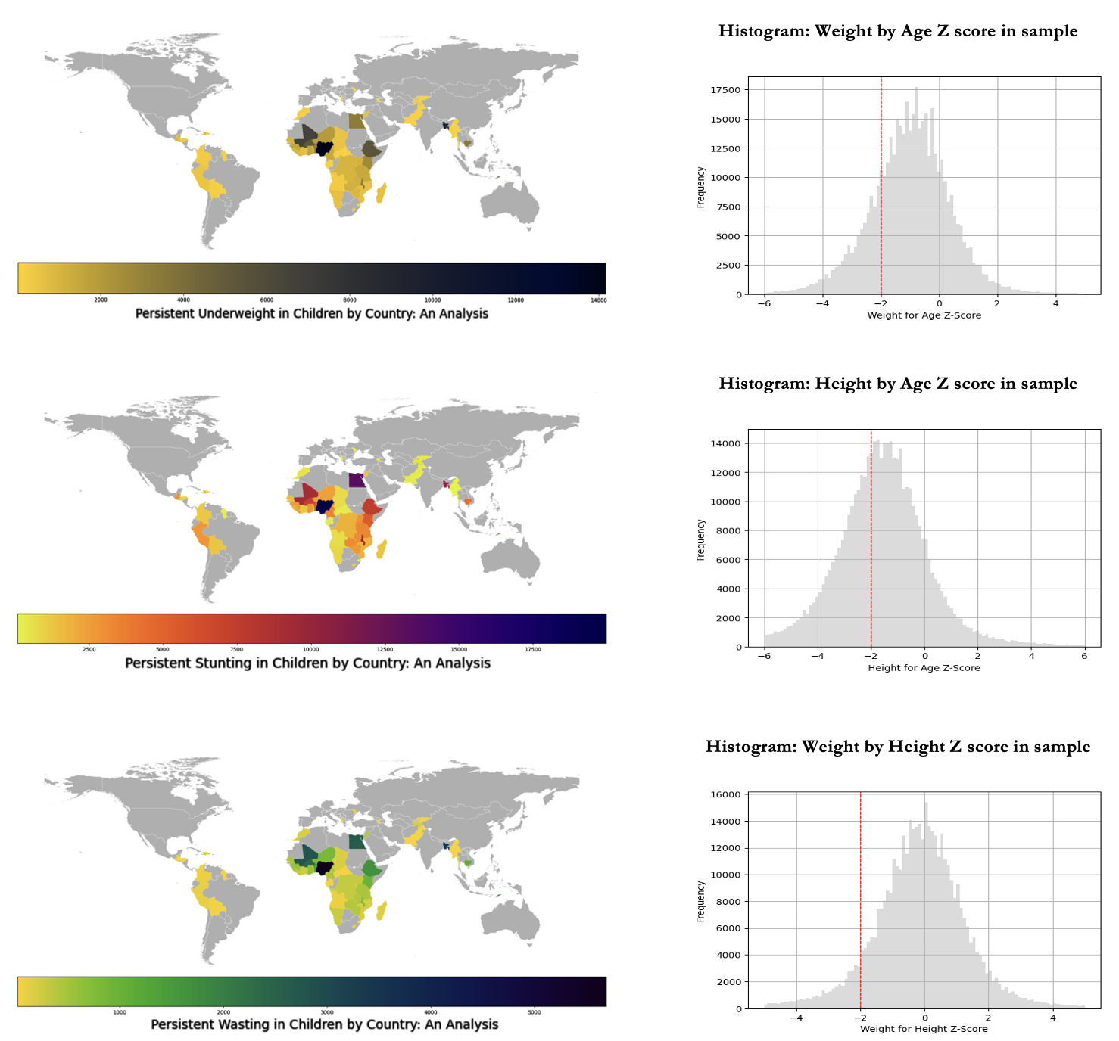
Results
Summary Anthropometrics
Underweight | 21%
Stunting | 38.3%
Wasting | 8.3%
Notes:
To better understand the prevalence of underweight in our sample, we analyzed the data and found that approximately 21% of children in our sample suffer from underweight. The following map displays the areas with higher prevalence of underweight, represented by the darker areas.
In our sample 38.3% of children are stunting
And 8.3 % are affected by wasting

Slide 11


Results
Temperature Effects on anthropometric outcomes on children
 | 1 | 2 | 3 | 4 | 5 | 6 | 7 | 8
VARIABLES | WAZ | WAZ | HAZ | HAZ | WHZ | WHZ | BMI | BMI
Monthly Temperature | -0.0500*** | -0.0176*** | -0.0185*** | 0.00377 | -0.0525*** | -0.0260*** | -0.0497*** | -0.0263***
 | -0.00436 | -0.00349 | -0.005 | -0.00389 | -0.00323 | -0.00288 | -0.00313 | -0.00284
Constant | 0.197* | -0.551*** | -1.102*** | -1.617*** | 1.095*** | 0.481*** | 1.220*** | 0.680***
 | -0.107 | -0.079 | -0.126 | -0.0894 | -0.0823 | -0.0658 | -0.0802 | -0.0651
Observations | 433,113 | 433,113 | 424,177 | 424,177 | 421,161 | 421,161 | 420,104 | 420,104
R-squared | 0.039 | 0.167 | 0.004 | 0.093 | 0.041 | 0.109 | 0.036 | 0.09
Year FE | No | Yes | No | Yes | No | Yes | No | Yes
Month FE | No | Yes | No | Yes | No | Yes | No | Yes
Country FE | No | Yes | No | Yes | No | Yes | No | Yes
Robust standard errors in parentheses
*** p<0.01, ** p<0.05, * p<0.1
Notes:
Our study indicates a negative correlation between higher monthly temperatures and weight-for-age and weight-for-height Z scores in children.
However, after taking fixed effects into account, we observed a weaker association between temperature and these measures, with a reduction of approximately 0.06 standard deviations.
Interestingly, the inclusion of fixed effects led to a change in the direction and significance of the association, suggesting that there may be some unobserved variables that affect the relationship between Monthly Temperature and HAZ and that these variables were not fully accounted for in the model without fixed effects.

Slide 12
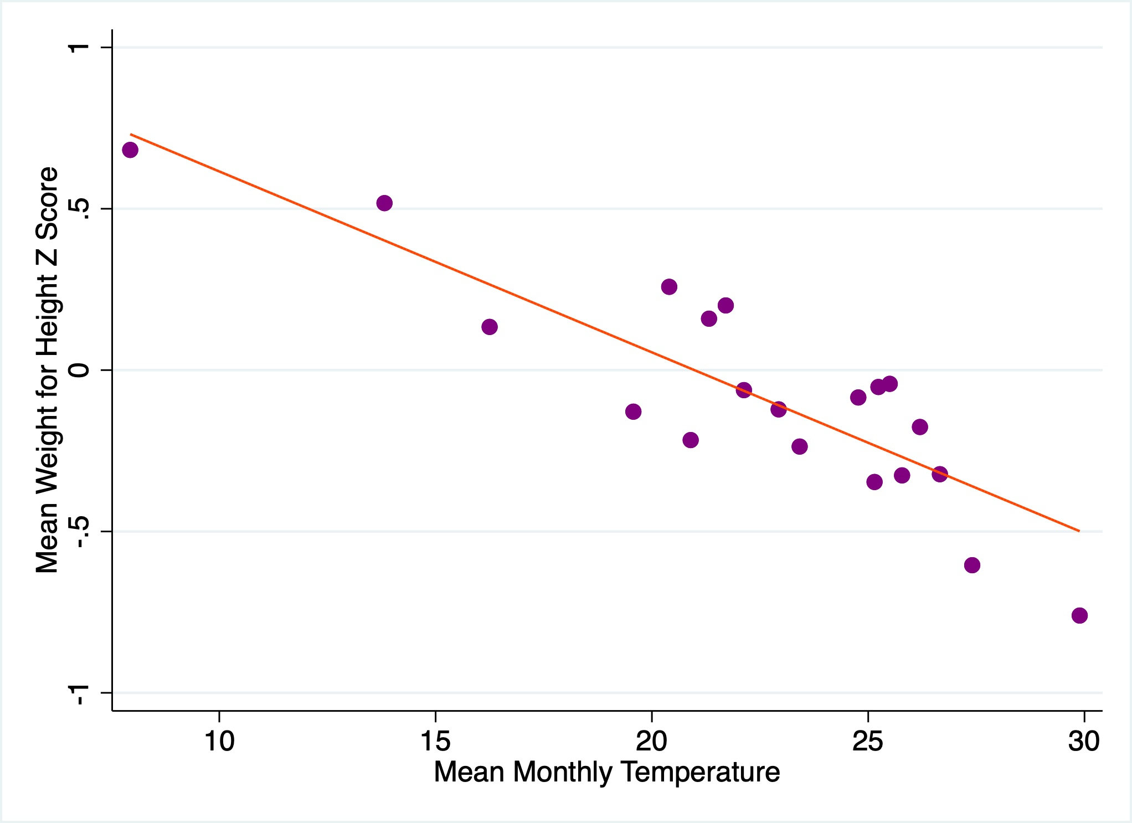
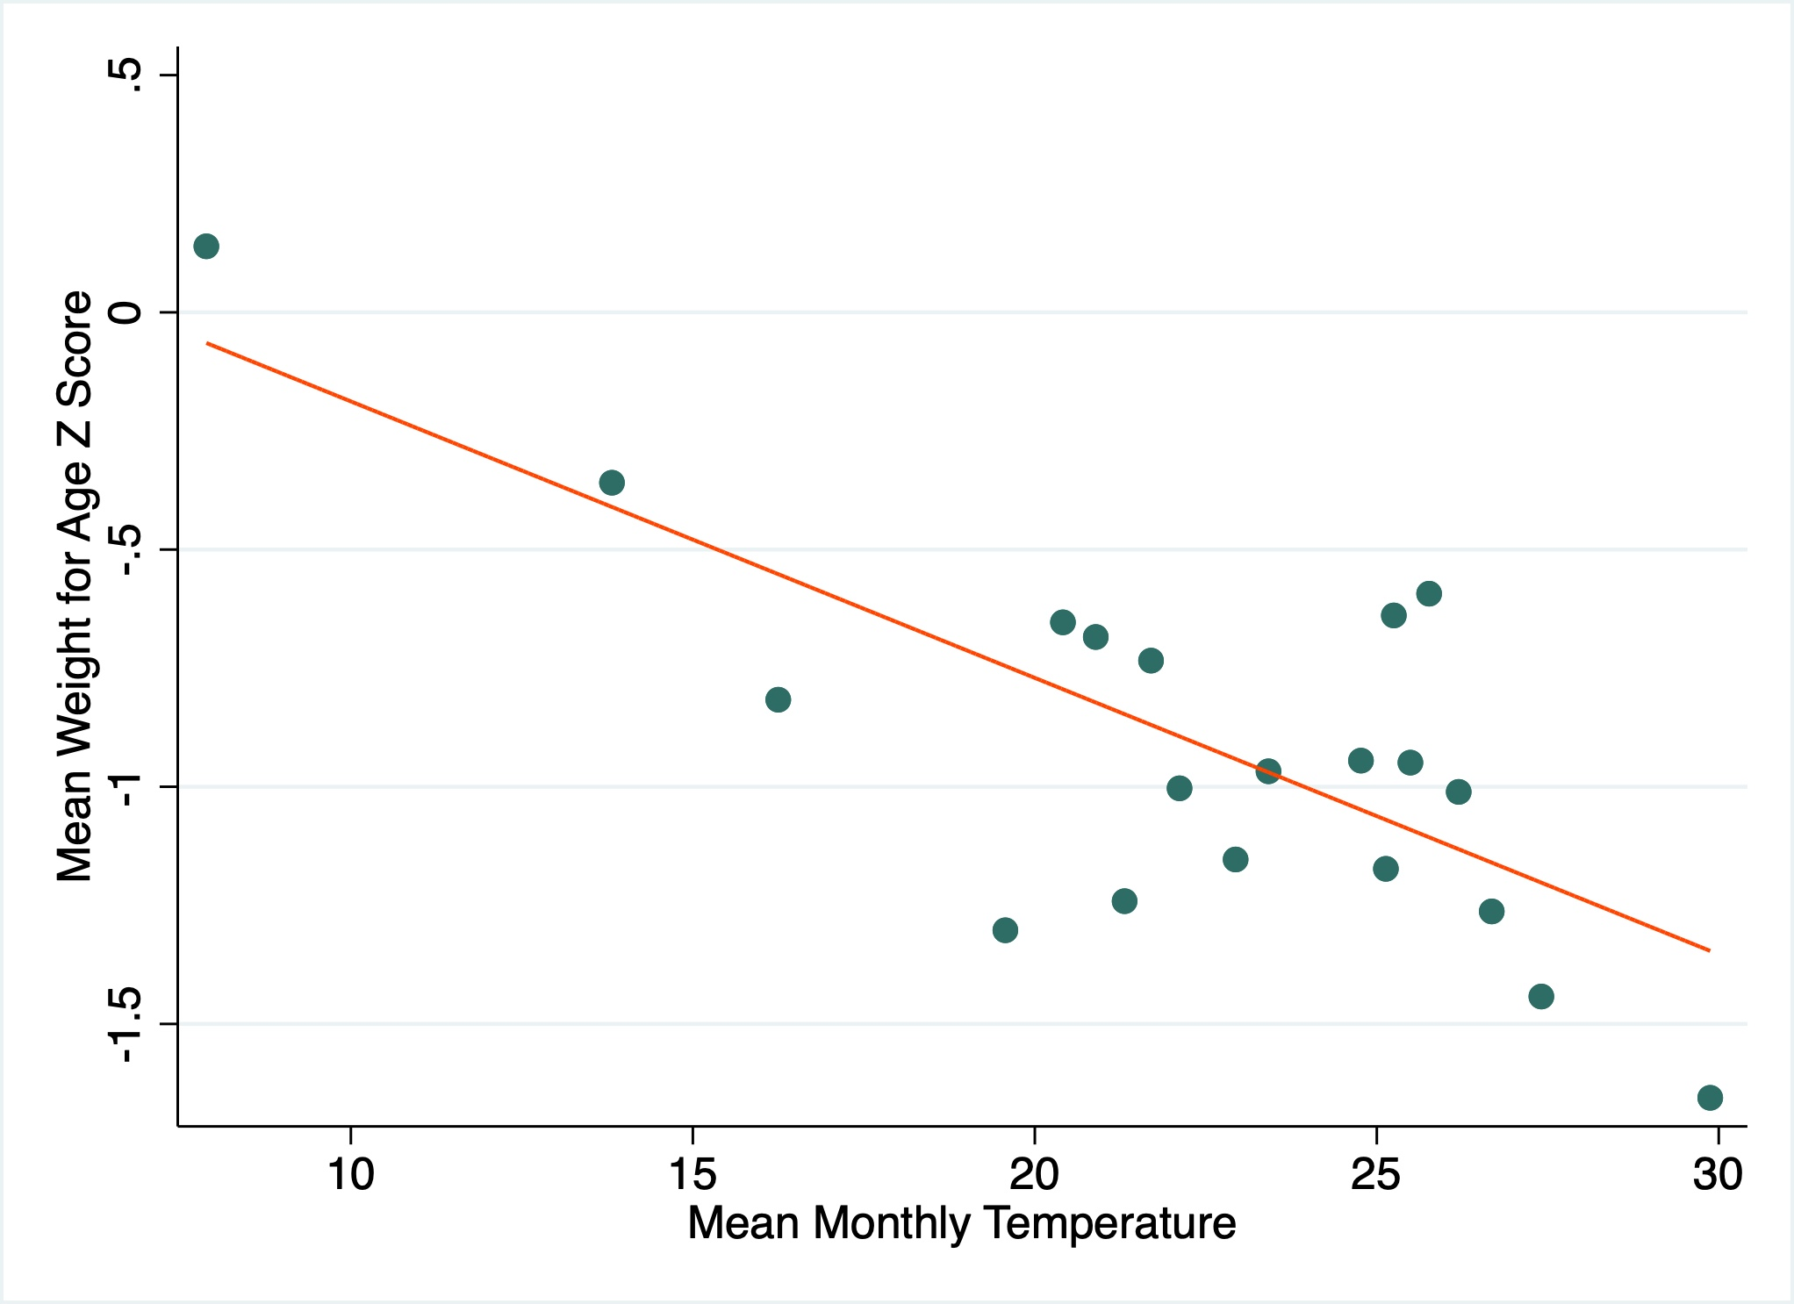
Results
Average Monthly Temperature Effects on Anthropometric Outcomes, collapsed by country
Notes:
1.As monthly temperatures increase, we observe a decrease in both WAZ and WHZ. Moreover, the scatterplot for WHZ reveals a stronger relationship for temperatures above 20°C compared to WAZ.
2.These findings suggest that high temperatures significantly impact child growth and development, especially in regions where temperatures regularly exceed 20°C

Slide 13
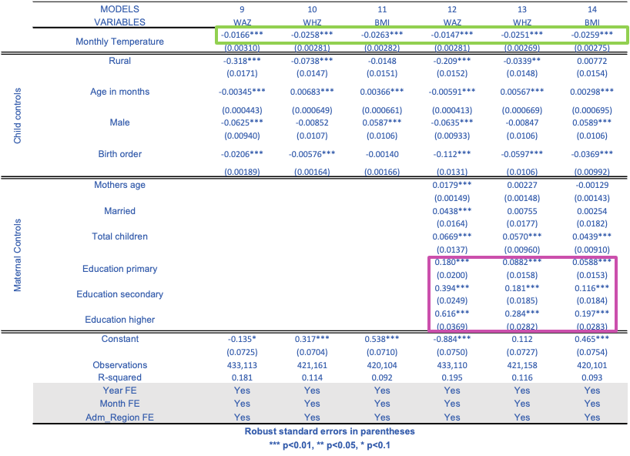
Results
Temperature Effects on Anthropometric Outcomes in Children: Comparison of Models with child controls and Fixed Effects.
Notes:
Monthly temperature has a direct and independent impact on weight-for-age and height-for-age z scores, even after controlling for confounding factors.
All maternal characteristics show a positive association with anthropometric outcomes, and higher maternal education is associated with better outcomes.
We also observe a difference in the direction of the age in months coefficient for WAZ and WHZ.
This is because WAZ measures chronic undernutrition, while WHZ measures acute undernutrition.
Older children with inadequate nutrition are more likely to be underweight, while older children are more resilient to wasting.

Slide 14
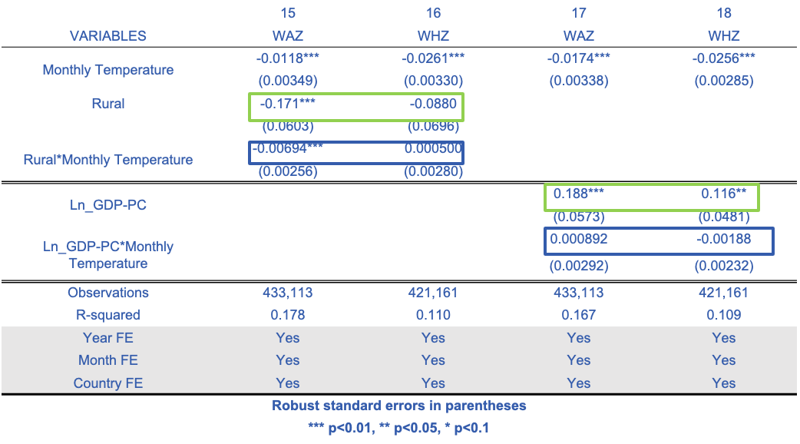
Results
Anthropometric Outcomes by Rural/Urban Status and Economic Status
Notes:
Rural residence has a significant negative association with WAZ, suggesting that children licing in Rural areas have lower z scores than those living in urban
The interaction indicates that effects of increasing temperatures on WAZ is stronger in Rural areas.
However the association between temperature in rural and WHZ is weeker.
Those results implicates that the relationship B/w T and child nutrition status may be confounded by other factorsSuch as households income and access to resources.

Slide 15
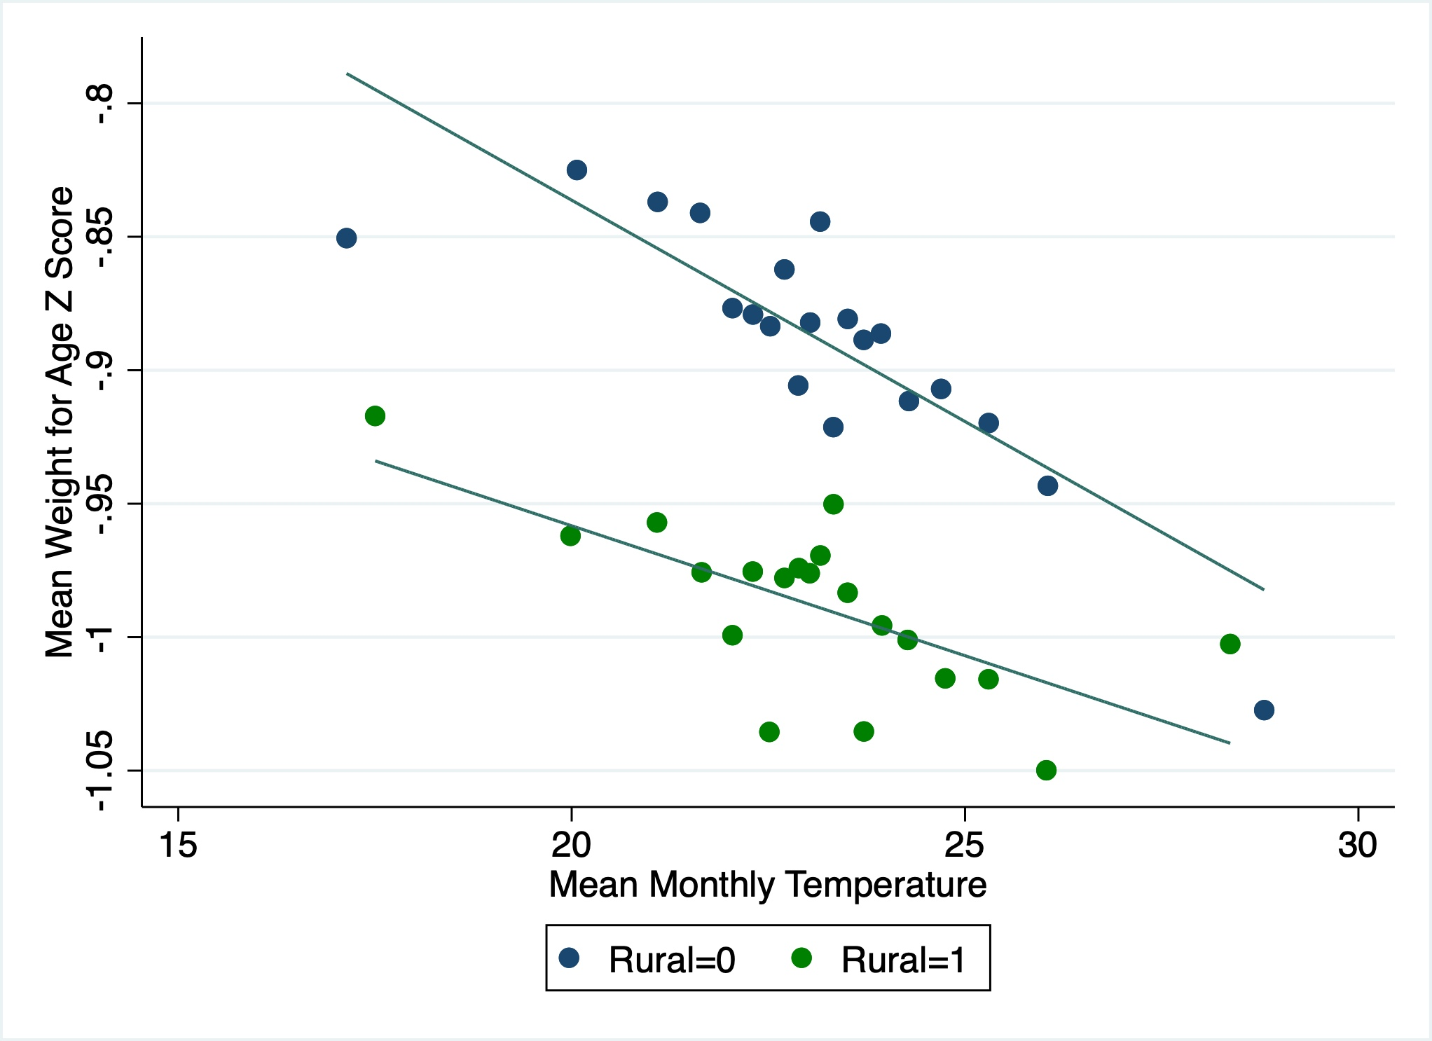
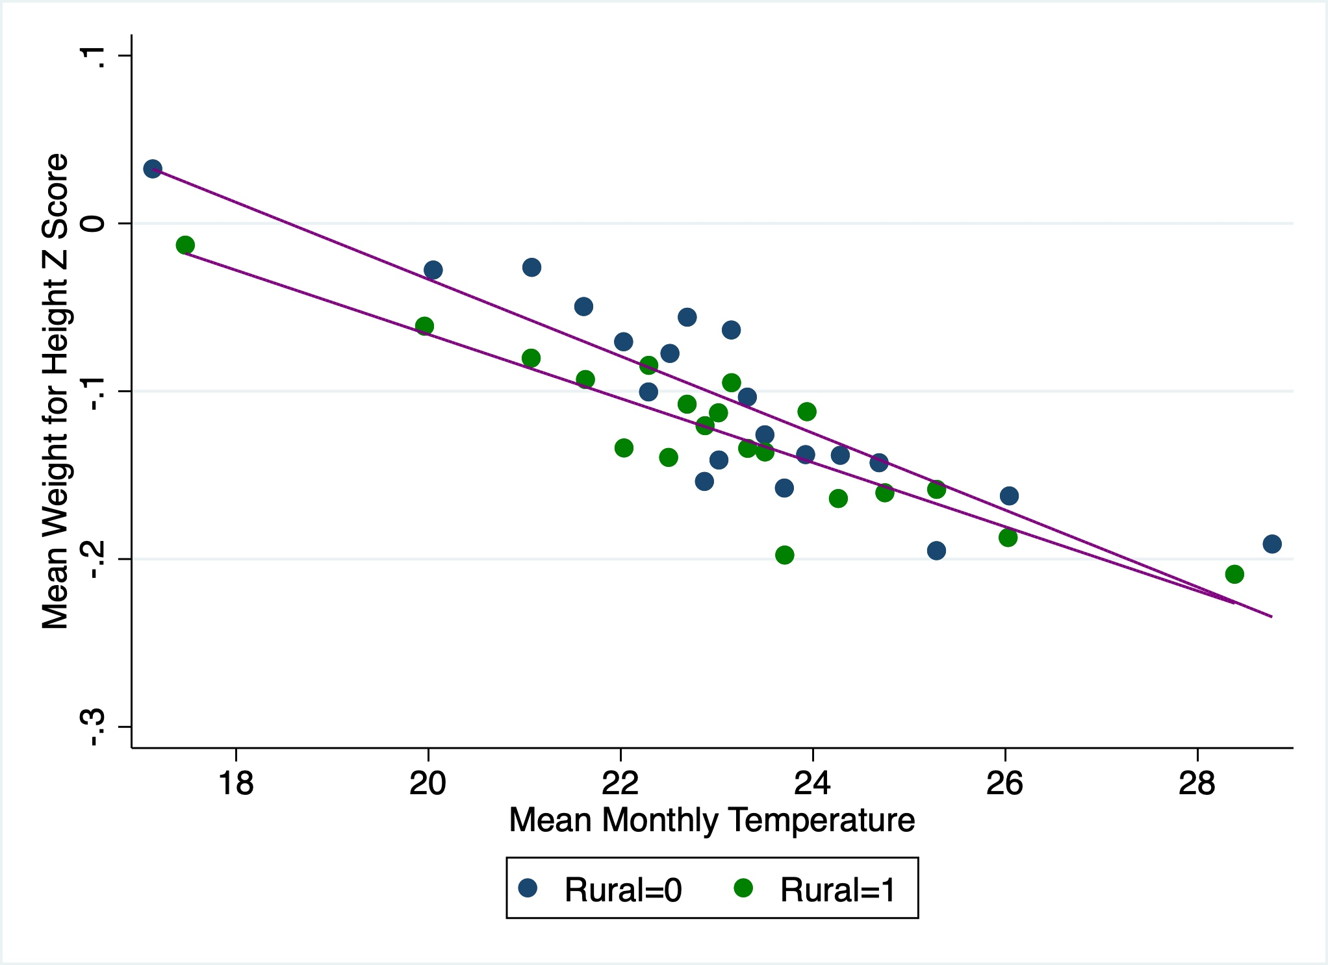
Results
Monthly Temperature and Anthropometric Outcomes for Rural and Urban Children: WAZ and WHZ Analysis
Notes:
Our analysis shows that rural children have lower WAZ scores compared to urban children at all temperature levels. The relationship between monthly temperature and WAZ is stronger for urban children. We also found a negative relationship between monthly temperature and WHZ for both rural and urban children, with similar slopes indicating a comparable effect on both groups

Slide 16
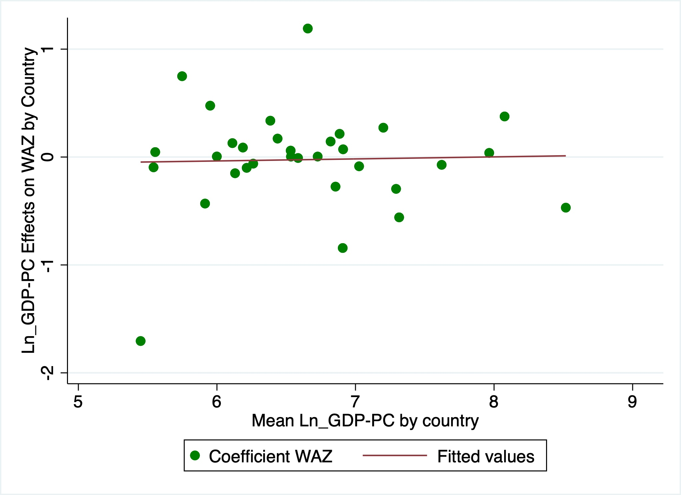
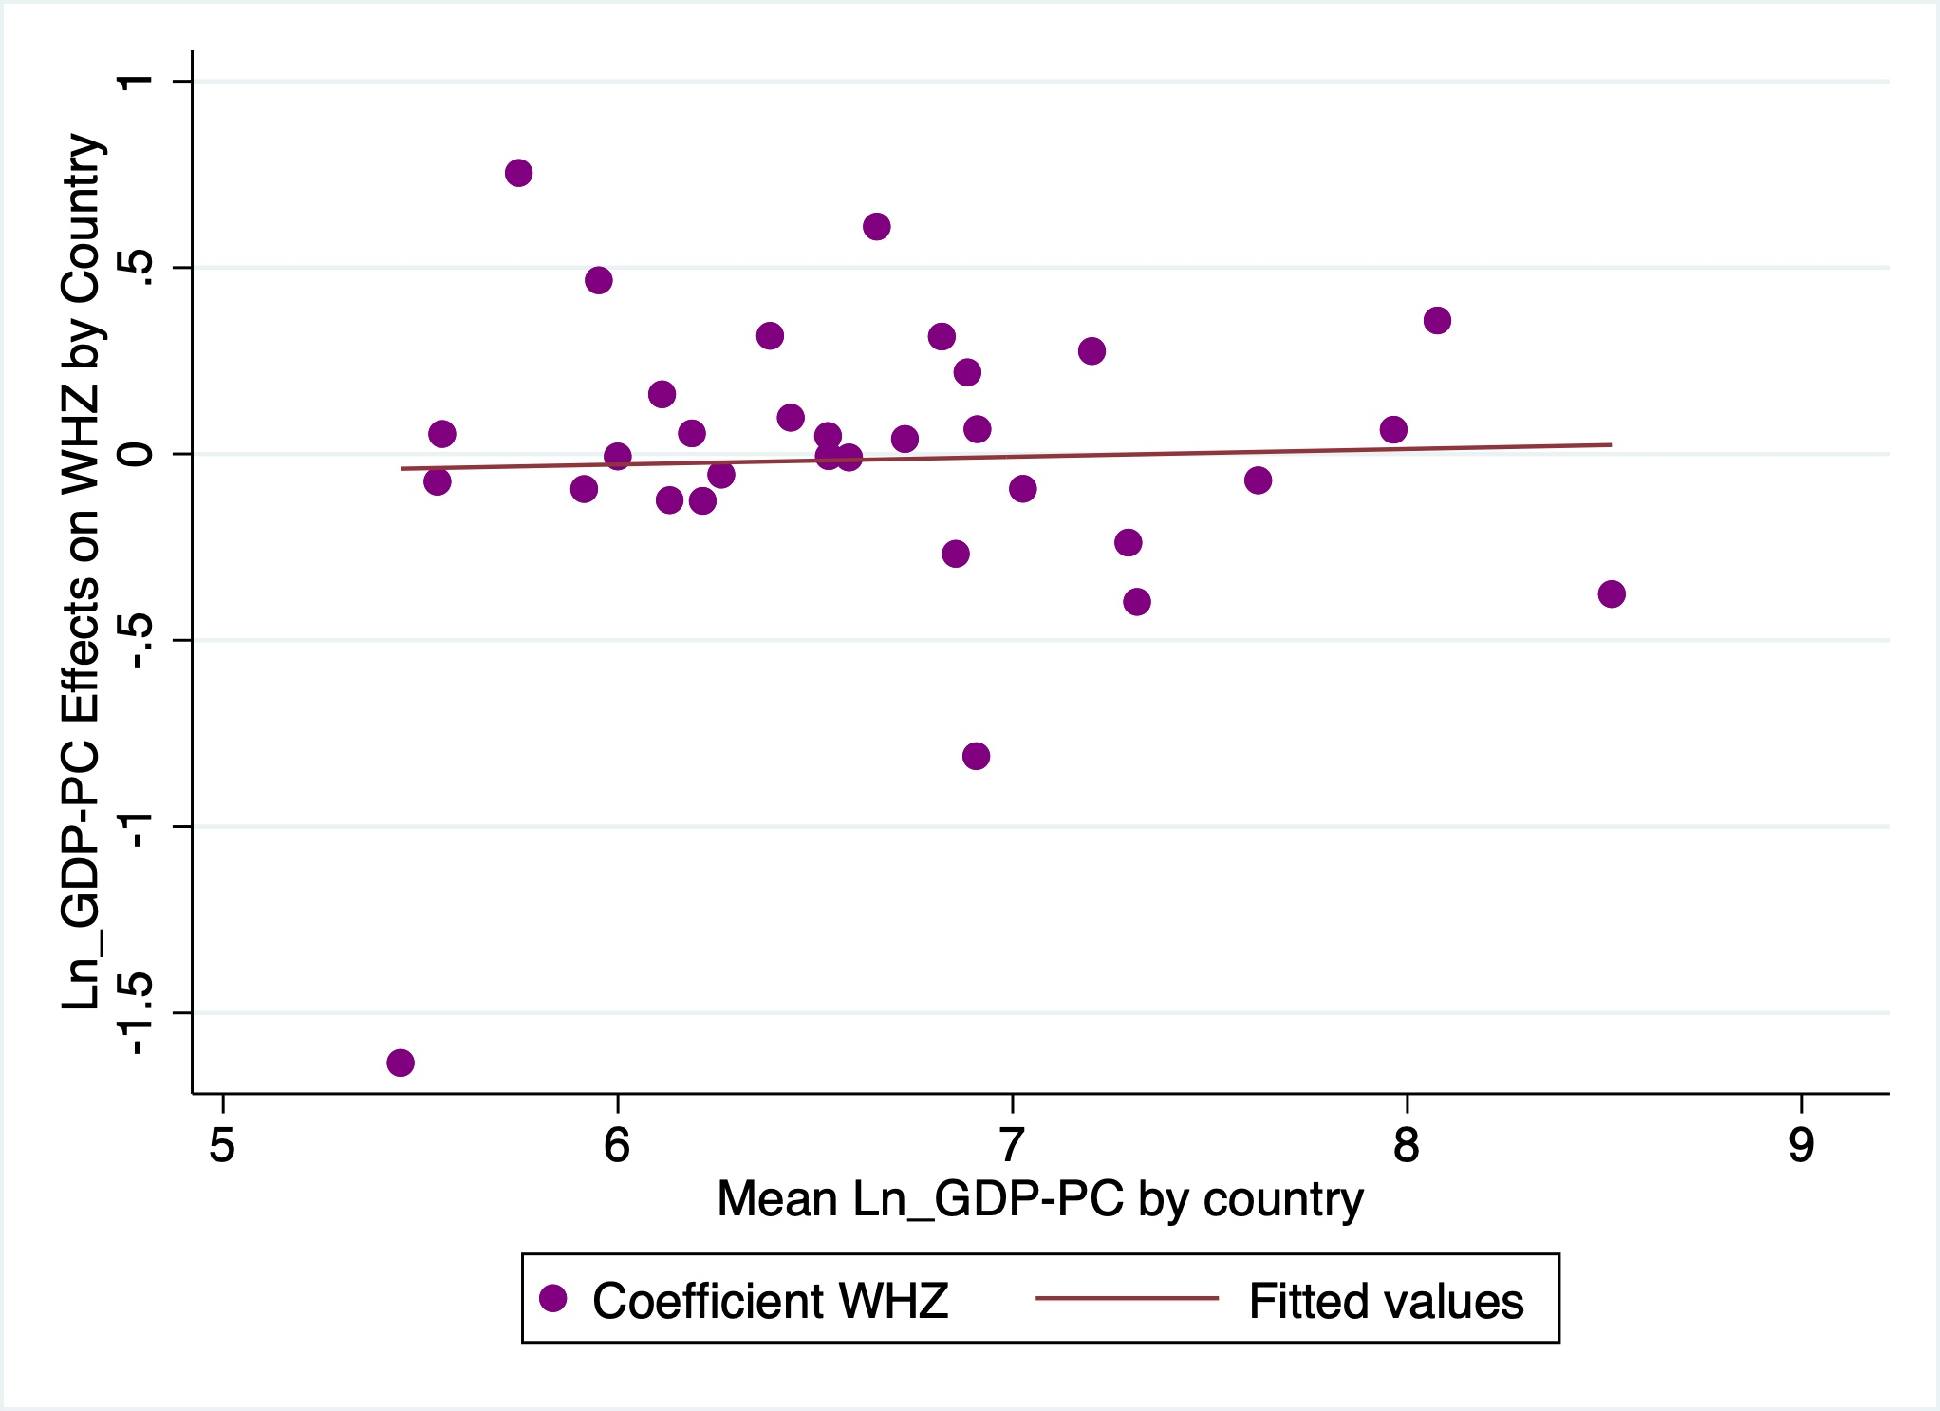
Results
Relationship between economic status and child undernutrition across countries
Notes:
The status of child undernutrition do not vary across countries.

Slide 17
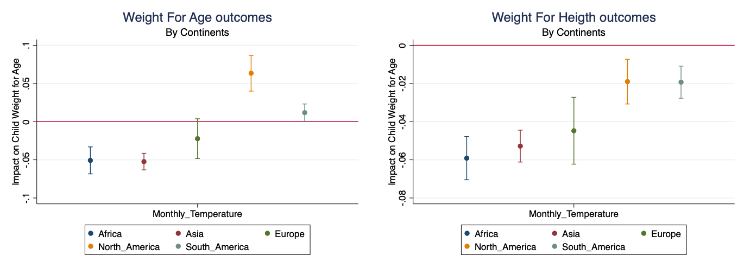
Results
Comparison of Impact of Monthly Temperature on Child Anthropometric Outcomes Across Continents.
Notes:
Comparing across continents.
A possible explanation is the information that we have in our sample of the countries that belong to these continents is sufficient, as well in Norht america there is better access to AC to mitigate this effects and differences of cultural practice related to feeding and care.

Slide 18
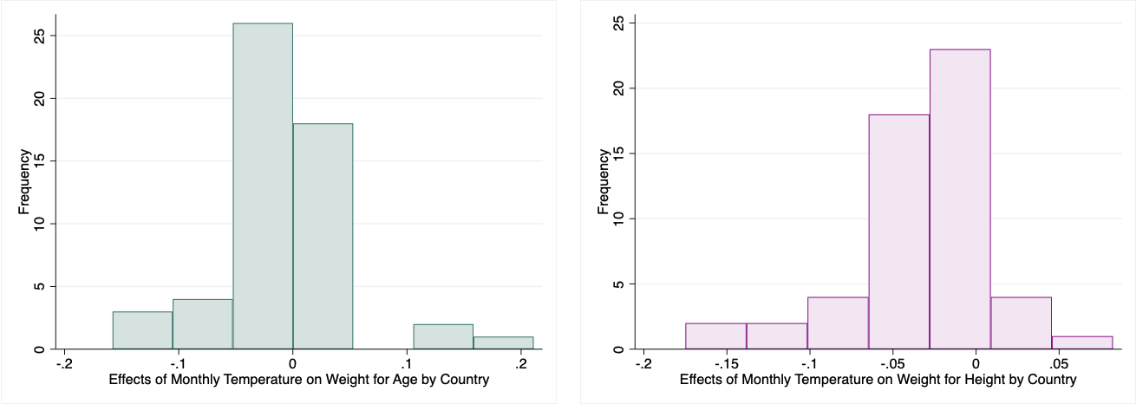
Results
The Impact of Monthly Temperature on Child Anthropometric Outcomes: A Global View

Slide 19
Conclusions:
High temperatures negatively affect children's weight-for-age and weight-for-height z scores.
Fixed effects weakened the observed association, implying unobserved variables can influence the relationship between monthly temperature and anthropometric outcomes.
Temperatures above 20°C significantly impact child growth and development in many countries.
Rural children have lower weight-for-age and weight-for-height z scores than urban children.
Economic status may not be a significant factor in explaining variation in child undernutrition across countries.
Our analysis reveals a consistent negative association between temperature increase and child anthropometric outcomes across most countries in our sample.
Future research should explore cross-regional variables, such as local sanitation, healthcare, and climate factors, to better understand the factors affecting anthropometric outcomes.

Slide 20
Thanks!
Do you have any questions?

